Slide 1
ACV - Term Project

Slide 2
Constraint
Your in progress project or research (Computer Vision Realted)
Any on going Competition related to Computer Vision
ex: Kaggle, CodaLab, AIDEA, AI CUP

Slide 3
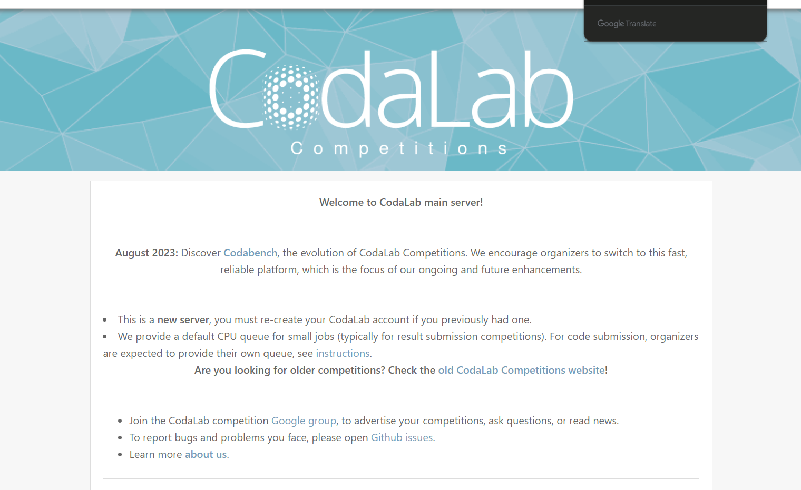

Slide 4
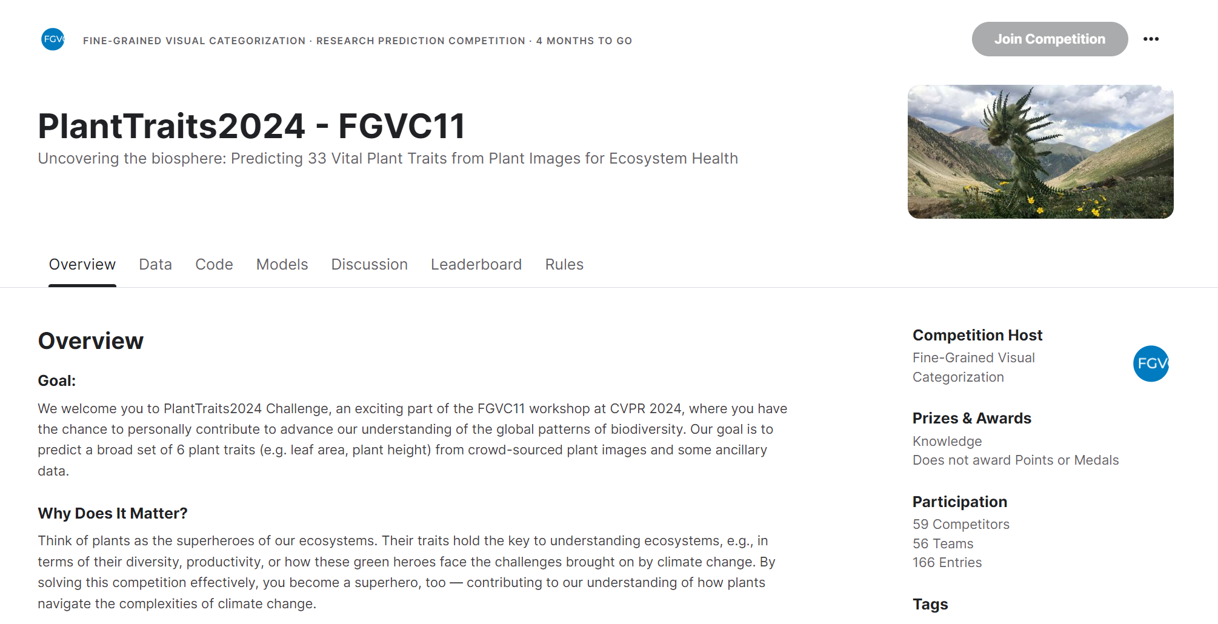
Kaggle - PlantTraits2024 - FGVC11
Website: LINK
Acceptance Deadline: June 16, 2024

